Slide 1
Problem Definitions
Time Titans
Jeremy Santoro, Austin Wasinger
Tony Duran, Tim Horton
James Greene

Slide 2
Problem Statement
To build an automated clock/display which can be updated via a server application, using a display that we build or buy. The application must be secure so that no one can tamper with the output of the display. The display will be controlled by a microcontroller that will save all the displays information in case of power outages.

Slide 3
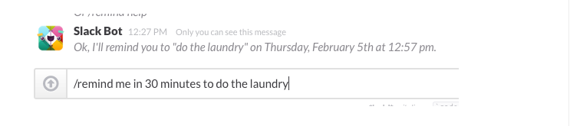
Slack
Set reminders
Pin documents
Nikabot (gant chart)
Polls
ideabot

Slide 4
Differentiate Needs vs. Wants
Display is major cross between both issues.
Professor Tekamp has displays that works perfectly and he is happy with but by building our own display we can complicate our project which currently is a major issue.
Professor Tekamp’s display is approximately 500 pixels while we could expand to 4000-6000 pixels with our own.

Slide 5
Exploring Project Boundaries
Customer size
Professor Tekamp has size limitations in mind but we need more specifics.
Power allotment from building
Using the strip LEDs is expandable to any size we want and we could possibly be told by the school that we cannot use more than a certain amount of power.

Slide 6

Pre-assembled LED boards
32 x 32 dot matrix
1024 LEDs
Smaller then Strip LEDs
7.5” x 7.5”
Enclosure included
$40

Slide 7
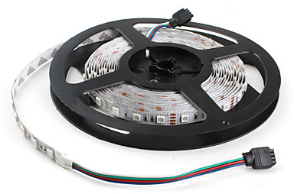
Strip LEDS
Any size we want
Any amount of LEDs we want
Larger bulbs
LEDs will sit further apart so display would be much larger without having more LEDs.
We must build mounting display as well.
$8.99 per 300

Slide 8
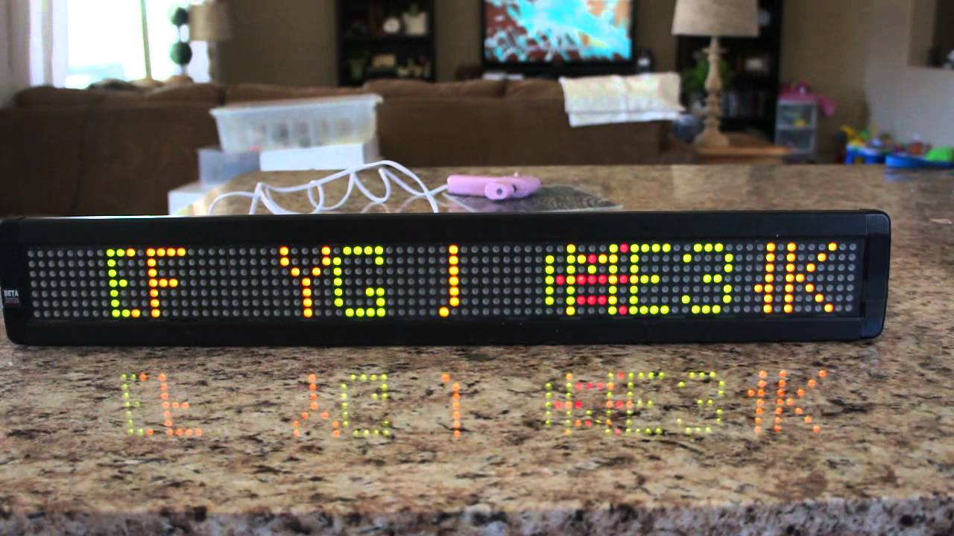
BetaBrite model 213C-1 Features
Can display 13 characters excluding condensed rotate mode(27 characters)
30kb of memory, store up to 65 messages
2 font sizes(1.5”, 2.1”), 2 fonts(serif, sans serif), 24 styles, 8+ colors
Backup battery – 1 month for messages, none for clock
Wireless keyboard
Password protection
26 display modes, 6 speeds

Slide 9
BetaBrite Cont
Connect to cpu by RS232 protocol (can be adapted to most things i.e. usb)
Priority messaging.
Audible alert
Supports POCSAG or pager transmission format wireless applications
110 or 230V, to plug in wall or install with overhead power
Wireless news and sports services. Extra service charge.

Slide 10
BetaBrite Specs
80 pixels wide x x7 pixels high
2.1” max character height
13 characters displayed at once
0.2” (0.05 cm) pixel width
10+ colors
Power : 7VDC at 3.25A, 50/60Hz
operating temp: 32 – 120F, 0-50C
Software can only program 1 or two displays at a time.
Preset functions make sending info easy.

Slide 11
Microcontrollers
Arduino Pro Mini 328 - 5V/16MHz - $6.99
Features:
Very small, lightweight
Cheap
Relatively low power
Needs WiFi Module

Slide 12
Arduino Wifi Modules
WiFi Module - ESP8266 - $6.95
Features:
WiFi Direct P2P
802.11 b/g/n

Slide 13
Raspberry Pi 3 Model B - $34.15
Features:
Has integrated WiFi
Has full operating system

Slide 14
Servers/DB
Design a website/database to hold display data.
Create a mySQL database to store trivia
Have different tables and relations for questions, answers, others
Free

Slide 15
Servers/DB
Create a web server on the microcontroller #rasberry pi
Would be able to access physical sensor information (temp, humidity, ambient level, etc)
Could connect through wifi or ethernet cable
Easy to integrate on small RAM with a microcontroller
Already needed if we use rasberry pi

Slide 16
Servers/DB
Use a hypertext link (or other way) to connect to website or school server
Have to be careful of copyright (probably not a big deal)
Already populated

Slide 17
Question?

